Slide 1
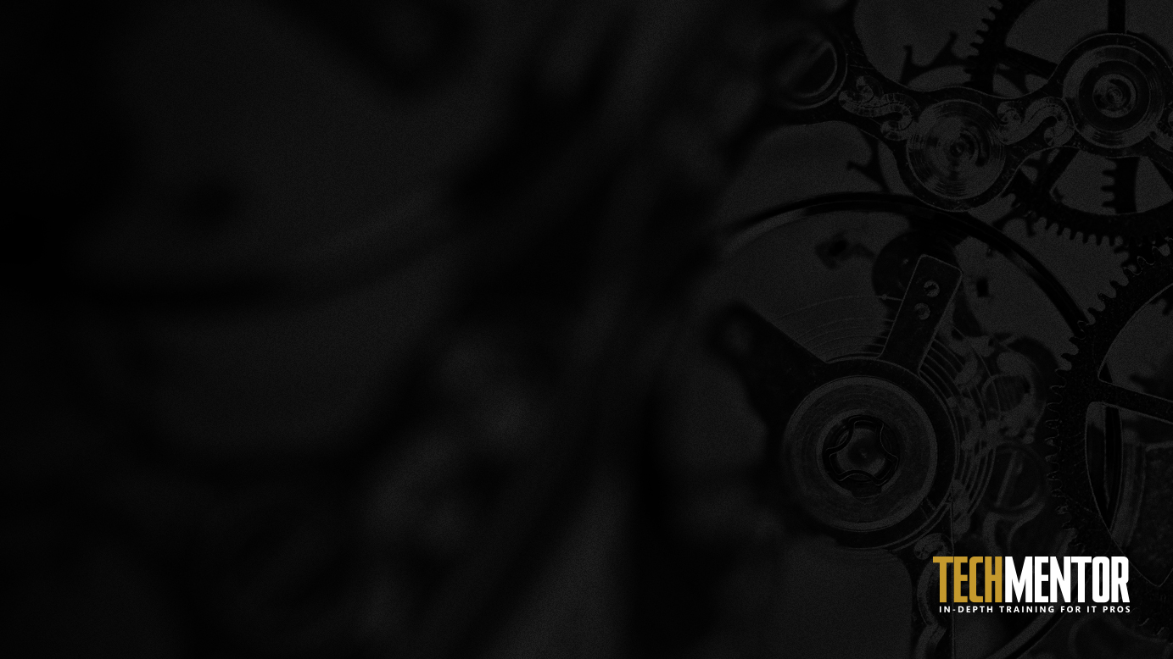
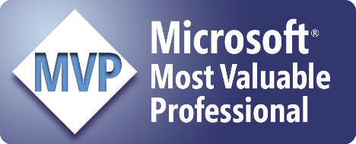
Automating Software Installs with PowerShell
Adam Bertram
PowerShell MVP
Notes:
Have you ever…
How’d you approach it? Did you use the same methodology as a similar piece of software?
That is what this talk is all about

Slide 2

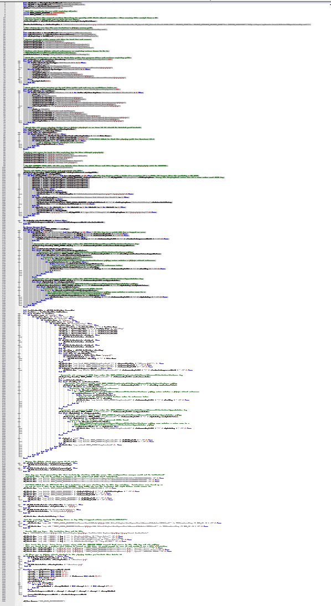
The 100 Hour Week
What on earth would require 100 hours in a week?
It rhymes with “itrix”
Lots of config differences
Helpdesk calls (My icon!)
Finance is down!
Kill me now!
Sleep
Boss: WTF? Me: Yep
Notes:
Anyone worked 100 hours in a week? …was it what you’d consider fun?
Application that rhymes with itrix that needed upgraded enterprise-wide from 12.4 to 13.
This app required different configurations whether it was a thin client, x86/x64, desktop, etc.
Citrix admin comes up to me on Friday..
Used the methodology for an old version and thought it’d work for the new version.
Pushed out to group on Monday evening..minor problems…fixed.
- Tested checking if in ARP and a single Citrix application..worked
Helpdesk calls about icon that’s changed the next day
Pushed out again on Tuesday evening..minor problems..fixed
Finance calls in a panic on Wednesday morning that their application won’t run.
- we didn’t test that application. It required another registry key to enable single sign on
The week continues like this until I eventually accumulated 100 hours
I was a consultant at the time for this client and my boss emailed me and said “did you make a typo on your timesheet”?
This could have been prevented if the versions didn’t change so much.

Slide 3
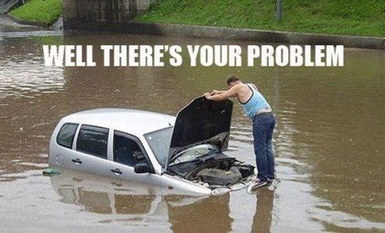
Well, There's Your Problem
Lack of Package Standardization
Hard to define “installed” and “uninstalled”
Post-install configuration needed
Cleanup work post-uninstall

Slide 4
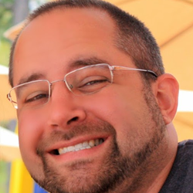
Whoami
PowerShell MVP
Consultant
Pluralsight Author (Free 1-Month Passes!)
Freelance Writer
Blog: adamtheautomator.com
Twitter: @adbertram

Slide 5
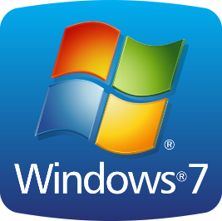
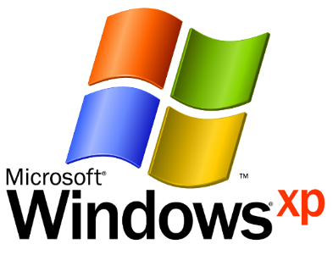

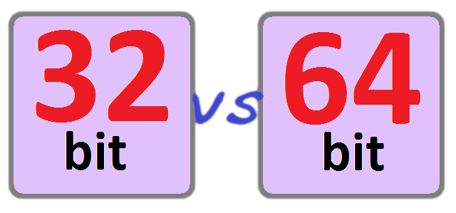
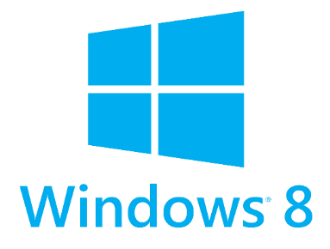
Is this Your Environment ?
Notes:
Does this look like your environment?
Who here has all Windows 8.1 and Server 2012 R2 only? …..are you hiring?
Each OS and architecture is different and needs to be accounted for.

Slide 6
What you can Expect and Will Learn
Lots of PowerShell
A PowerShell session at no extra charge!
Lots of demos!
Ask questions any time!

Slide 7

Sorry, no Shiny things here
Nothing new and shiny
Git 'er Done Scenarios
What it takes to get the job done
Notes:
This talk is not going to concentrate on any new technology
We’re using native PowerShell code
- no PowerShell Package Manager
- no DSC

Slide 8
Where did this talk come from?
SCCM Administrator
Frustration! Why did you do this?!
Necessity
To prevent recreating the wheel
Notes:
Extreme frustration with software vendors
Was a SCCM admin for 5 years and got tired of the different ways vendors packaged their software
Tired of recreating the wheel
Came from necessity, a grass roots effort
Whatever had to be done

Slide 9
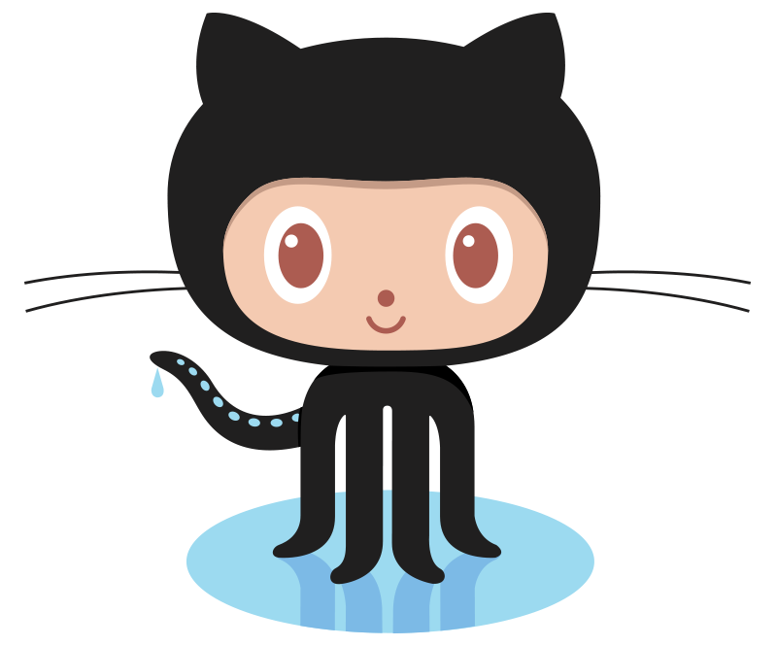
The PowerShell Module
https://github.com/adbertram/SoftwareInstallManager
Notes:
Talk will focus on the SofwareInstallManager PowerShell module
It’s on Github
It’s not perfect so help me out

Slide 10
What's Required of You
Intermediate PowerShell skills
Linkie
A raving fan of PowerShell
CMTrace
v2
The PowerShell Module
The Windows Installer Module
At least PowerShell v2 installed on clients
Notes:
Who here is not a raving fan of PowerShell?

Slide 11
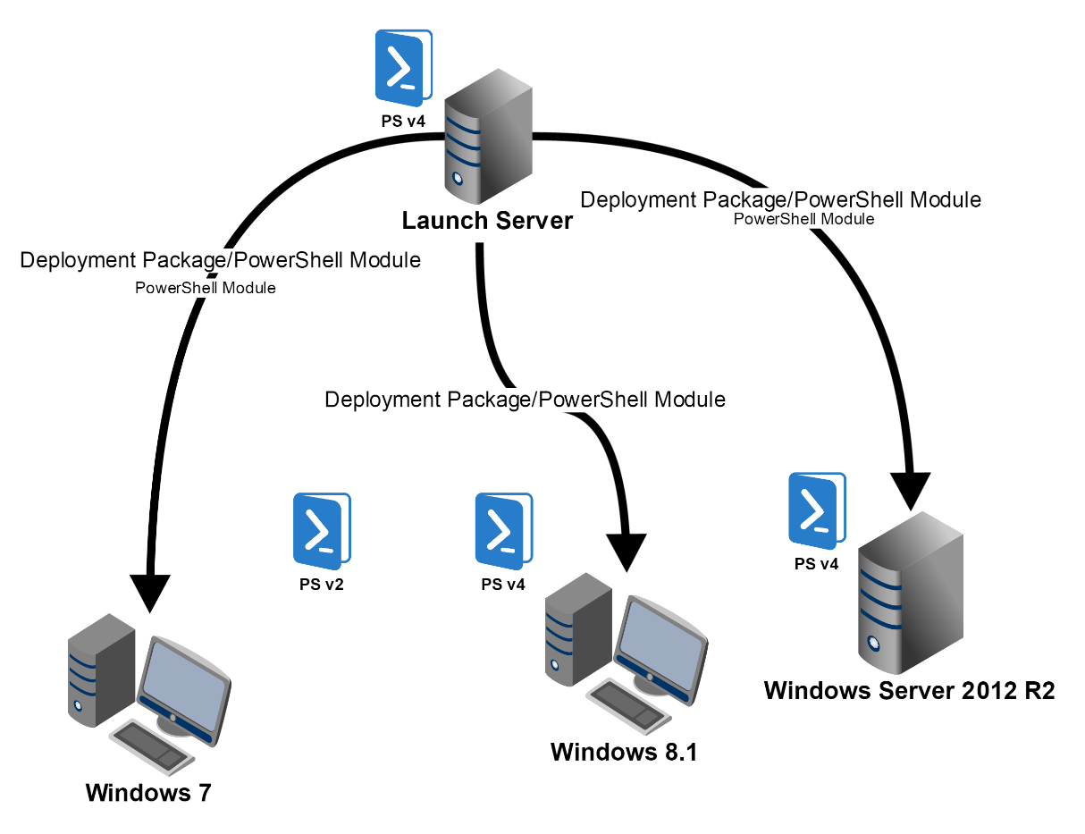
Demo Environment

Slide 12
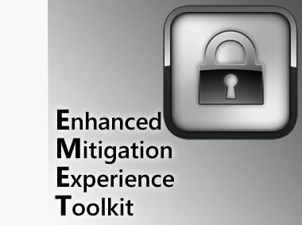
Demo: Deployment Walkthrough
Step-by-Step
Manual Deployment
Mimicking the Actual Launch Script
A Well-Behaved MSI with a dependency
Notes:
Taking the launch script’s activities step by step
- Manually showing each piece of the launch script and how it executes the deployments
Picked EMET because it’s easy (NOT the norm!). Can be installed with minimal effort with default methods

Slide 13
The Launching Script (A Poor Man's SCCM)
Server Tests
Client Tests
Client Monitor
Deploy
Cleanup
NOT needed if you have another tool

Slide 14

Demo: Adobe Reader
Windows Installer Package (MSI)
Two Deployments
Default Install First
Customizing Install with a TRANSFORMS (MST)

Slide 15
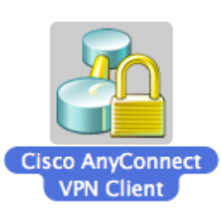
Demo: Cisco AnyConnect
Multiple MSIs at once
Using MSTs
Set-RegistryValueforAllUsers​
Notes:
Using the flexibility of a PowerShell script you can do anything you want
This does multiple MSIs in the same deployment with a MST
AnyConnect breaks out MSIs into different program functions
AnyConnect has connection notices that show up in the systray. A registry value prevents that

Slide 16
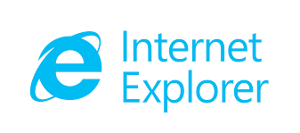
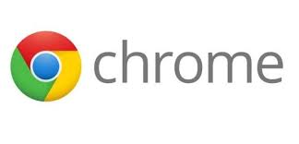



Demo: Web Apps Need Deployed?
Shortcuts, Oh My!
New-Shortcut

Slide 17
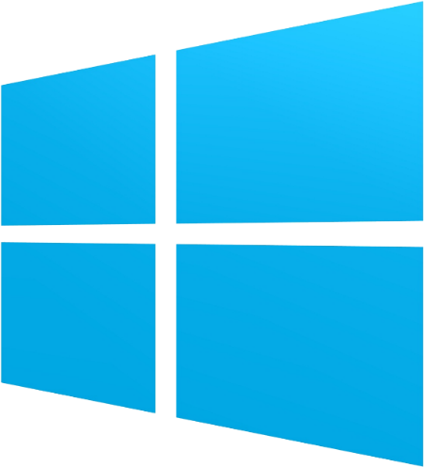
Demo: Windows Features
Deployments...not just for clients
Deployments don't have to be third party software
PowerShell automates anything!

Slide 18
Demo: What's "Installed" Actually Mean?
Just in Programs and Features? Yeah, right.
Registry keys
File Locations
File Versions

Slide 19
Building useful logs
Easily consumable
Severity Levels
Verbose

Slide 20
When to Log
Before and after "events"
Trouble spots
Conditional statements

Slide 21
Introducing CMTrace
Linkie
System Center 2012 R2 Configuration Manager Toolkit
Reads a standard log format

Slide 22
Demo: Logging
Writing a Write-Log function
Log levels
Errors : Bad stuff
Warnings : Sorta bad stuff
Common : Normal stuff
Before and after events

Slide 23
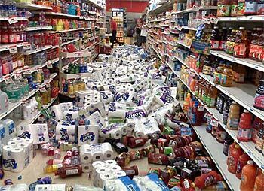
Automating Software Uninstalls
Cleanup on Aisle 5!
All About Detection and Removal
Cleaning up after vendors
Notes:
Unfortunately, not all (most!) applications clean up after themselves.
We have to pull install folders, registry stuff, files placed in AppData, temp folders, etc.
To develop a complete software deployment solution you must account for this stuff.
What’s also important is detecting both when you need to perform some manual intervention and when it’s removed

Slide 24
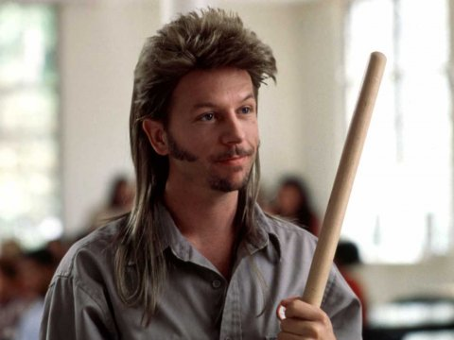
Uninstall Cleanup
App Shortcuts
Registry keys
Install folders
Certificates
Notes:
Have you guys ever seen Joe Dirt? Awesome movie.
The best representation I could come up with.
I always felt like a code janitor having to cleanup after these software vendors!
Even when you uninstall the software like they recommend it always leaves stuff behind.

Slide 25
Demo: Web App Removal
APPS
No shortcut will be missed!

Slide 26
Demo: EMET Uninstall
Simple
Clean
Me likey

Slide 27

Demo: Adobe Reader Uninstall
Not so simple
Will fail if Reader is open
Leaves lingering AppData folder

Slide 28
Demo: Cisco AnyConnect Uninstall
Multiple MSI Uninstalls
Leaves folders and registry keys behind

Slide 29
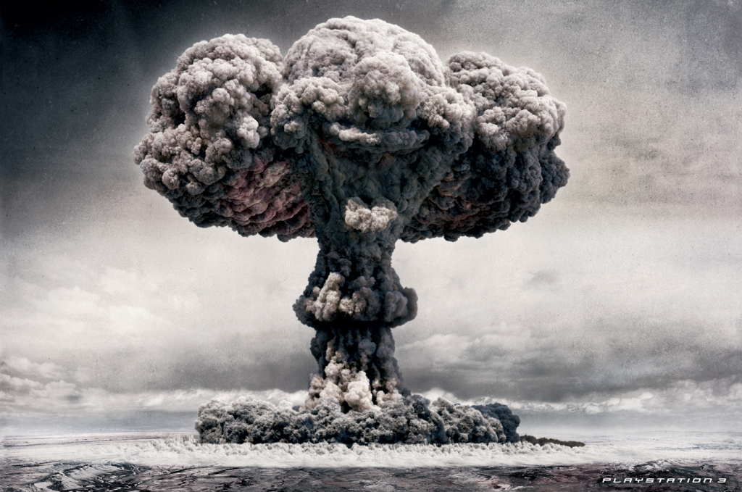
Stubborn Applications
Some apps really want to stay installed
You must go nuclear
MsiZap
Notes:
Healthcare applications..thinking it was a GE or a Siemens app that would not uninstall
Handle with care

Slide 30
Automating Software Upgrades
Upgrades are Hard
Detect
Uninstall (maybe)
Install
Detect

Slide 31

Demo: Adobe Flash Player Upgrade
Fairly easy
Is just an EXE installer

Slide 32
Demo: Adobe Reader Upgrade
Upgrading from v7 to v11
Requires using third party removal tools

Slide 33
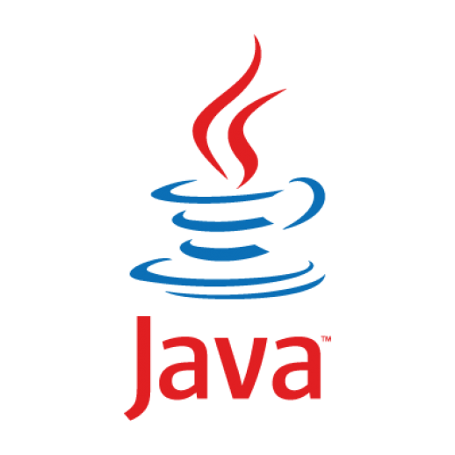
Demo: Java. Enough Said
New versions constantly
Horribly insecure
Multiple versions (at the same time!)
App dependencies on old versions
PITA
Did I mention PITA?

Slide 34
Demo: User Profile Scripting
Creating files
Removing files
Shortcuts
Whatever!

Slide 35
Your Job is Never Done
This isn’t perfect
Software vendors will keep being software vendors
Contribute!

Slide 36

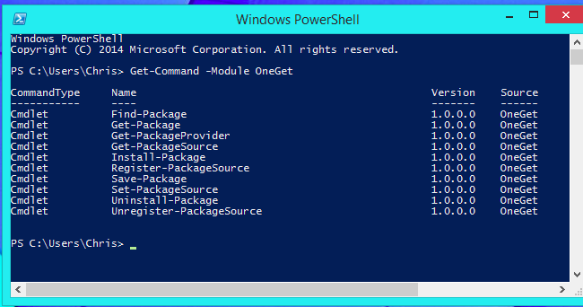

Other Options
PowerShell Package Manager
Chocolatey
BoxStarter

Slide 37
Thank you! Please tip your waiter

